Slide 1
Rain-Related Car Accidents: A Statistical Analysis
Jose Duarte
DS530
3/2/25

Slide 2
Introduction
Research Question: Is rain the main weather condition associated with car accidents?
Objective: Analyze the impact of rain on accident frequency and severity.
Data Sources: NHTSA(National Highway Traffic Safety Administration) https://www.kaggle.com/datasets/sobhanmoosavi/us-accidents

Slide 3
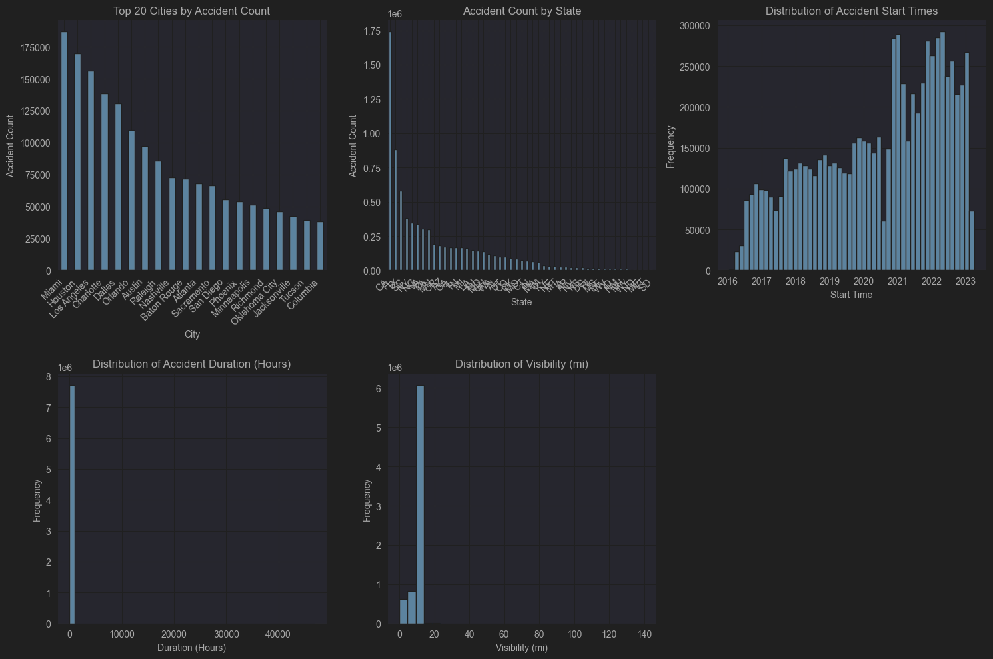
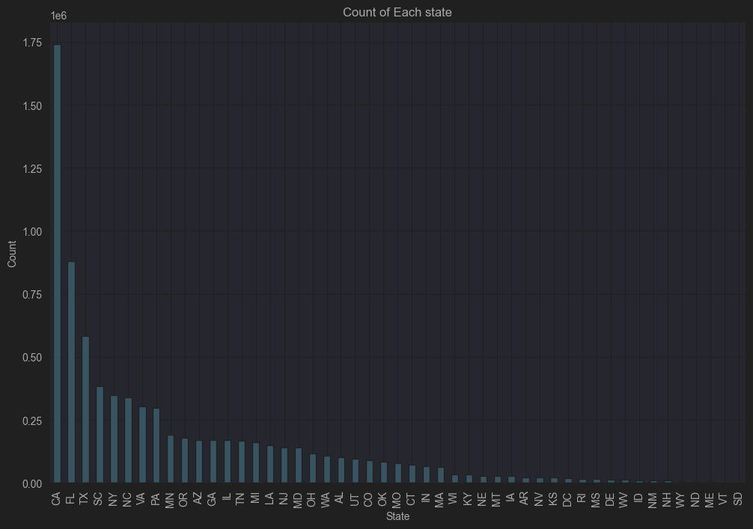
Key Variables in Analysis
Temperature(F)
Precipitation(in)
Wind Speed
Visibility(mi)
Pressure(in)
These first 5 variables show the weather conditions that are present during the accidents that took place. This directly impact our question whether most accidents have rain conditions during the time of accident.
State
City
Street
Day (weekday/weekend)
Hour(time)
Duration(hrs)
This next 6 variables provide the location of these accidents that can indirectly help answer our research question. Some cities are very busy due to heavy population. More people, more room for driver error, which cause accidents.

Slide 4
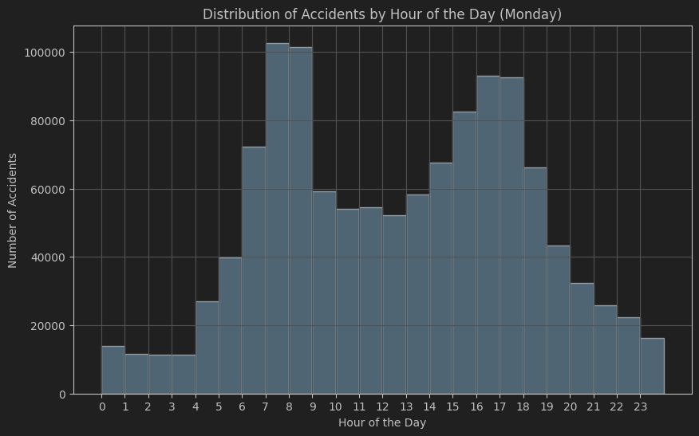
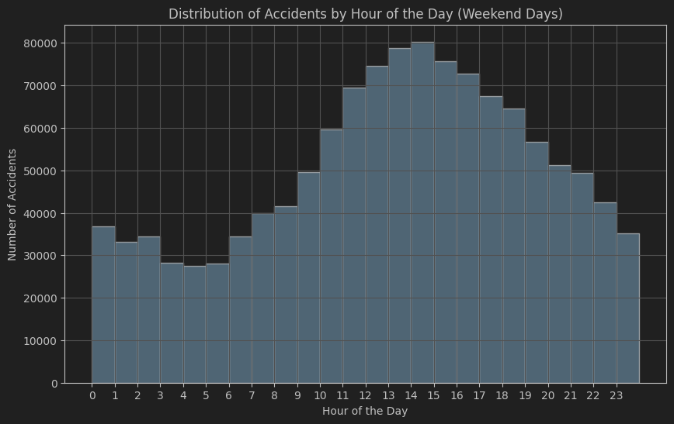
Histograms and Outliers
Histograms for each variable.
Identification of outliers using Z-score analysis.
Explanation of how outliers are handled (e.g., removal, transformation).
Distribution of accidents on hour of the day on weekdays.
Distribution of accidents by hour on Mondays.
No outliers were detected on this data set, although there was missing values which was shown on the plots of accidents per city.

Slide 5
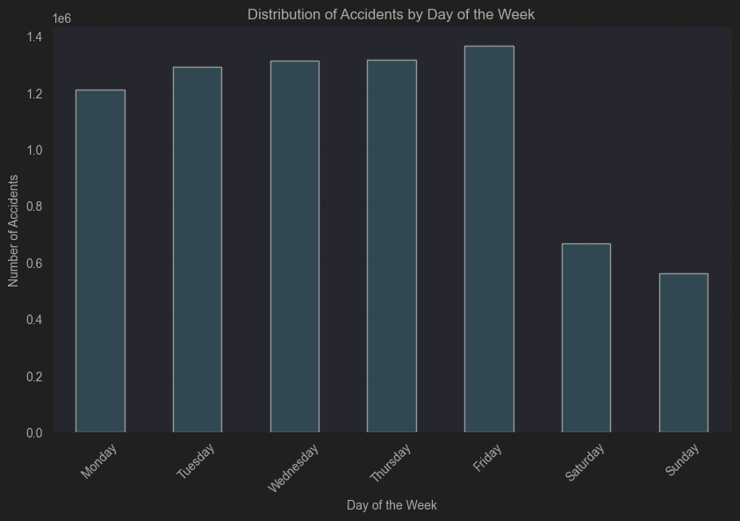
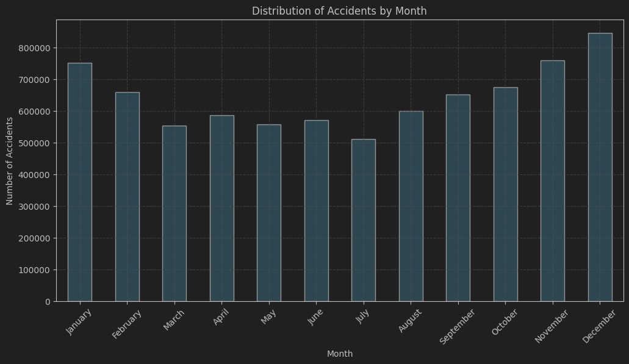

Slide 6
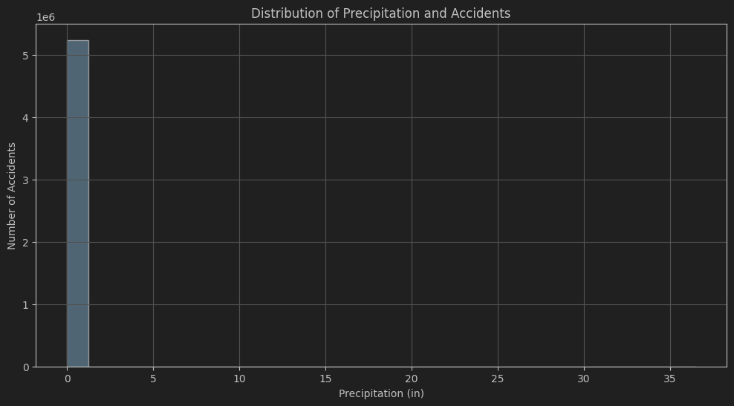
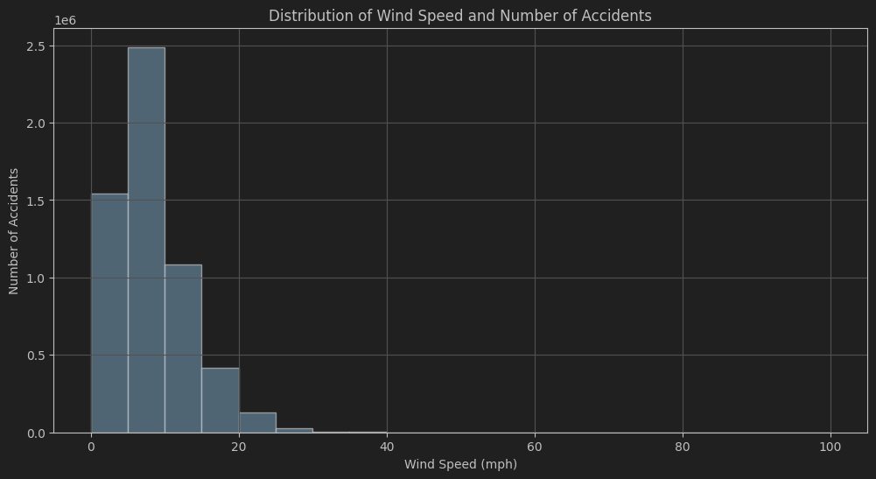

Slide 7
Descriptive Statistics
Descriptive Statistics for Duration_Hours:
Mean: 7.407015947872805
Median: 1.2472222222222222
Mode: 6.0
Standard Deviation: 225.20487592083975
Skewness: 50.63729120659499
Kurtosis: 3659.599743150461
Descriptive Statistics for Visibility(mi):
Mean: 9.090376447963356
Median: 10.0
Mode: 10.0
Standard Deviation: 2.6883159214171397
Skewness: 2.3166628398197555
Kurtosis: 81.89391923469647
Weather Condition: Mode - Most frequent weather condition in accidents.
Crash Severity: Mean and spread of severity levels.
Visibility: Mean, spread, and tails.
Rainfall Intensity: Distribution characteristics.
Road Condition: Mode and impact on accidents.

Slide 8
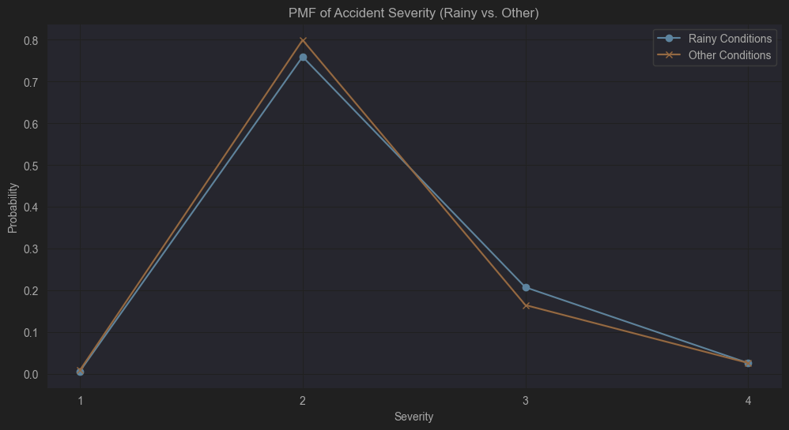
PMF Comparison
The PMF shows the probability of different severity levels for accidents under rainy and other weather conditions.
Comparing the two PMFs helps understand if rainy conditions increase or decrease the likelihood of certain accident severity levels.
For example, if the PMF for rainy conditions shows a higher probability for higher severity levels, it suggests that rainy weather may lead to more severe accidents.

Slide 9
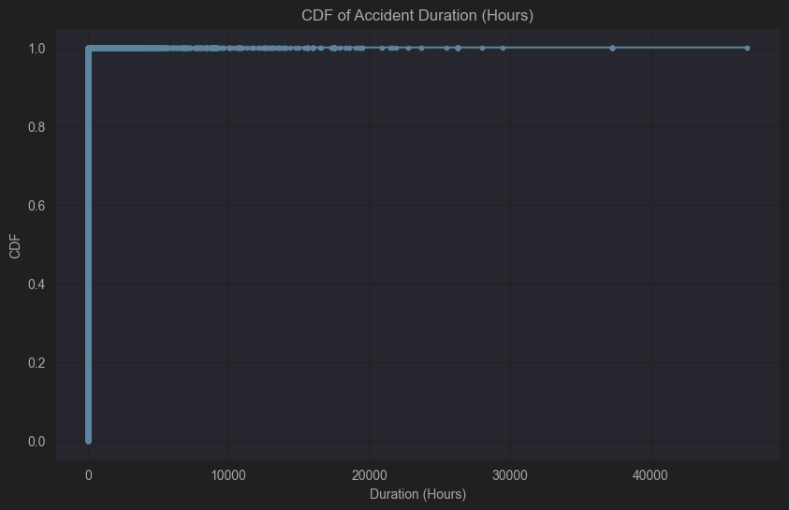
CDF Analysis
The CDF shows the cumulative probability of accident durations.
A steep rise at the beginning indicates that many accidents have short durations.
The long tail shows that some accidents have very long durations (outliers).
This tells us the likelihood of an accident lasting less than a certain number of hours.
For example, we can see the probability of an accident lasting less than 1 hour, 5 hours, etc.

Slide 10
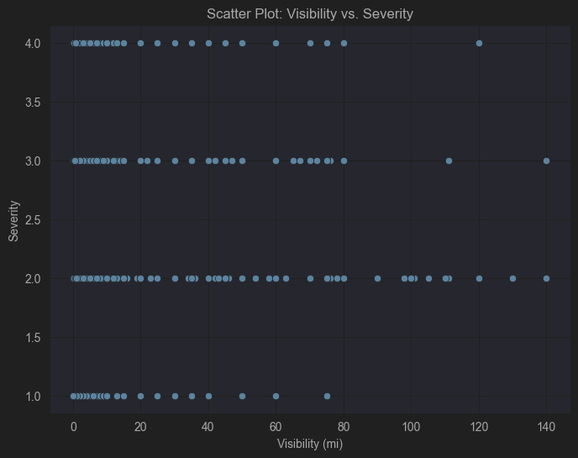
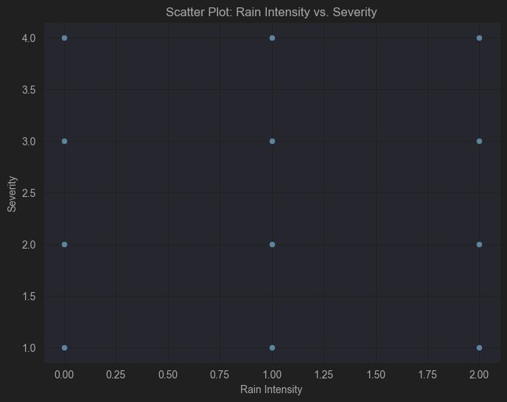
Scatter Plots and Correlation
Correlation Analysis:
Correlation between Visibility and Severity: -0.0035
Correlation Analysis:
Correlation between Visibility and Severity: -0.0035
Correlation between Rain Intensity and Severity: 0.0231
Interpretation:
The scatter plots and correlation coefficients provide insights into the relationships between the variables.
A negative correlation between Visibility and Severity suggests that lower visibility is associated with higher severity.
A positive correlation between Rain Intensity and Severity suggests that higher rain intensity is associated with higher severity.
However, remember that correlation does not imply causation.

Slide 11
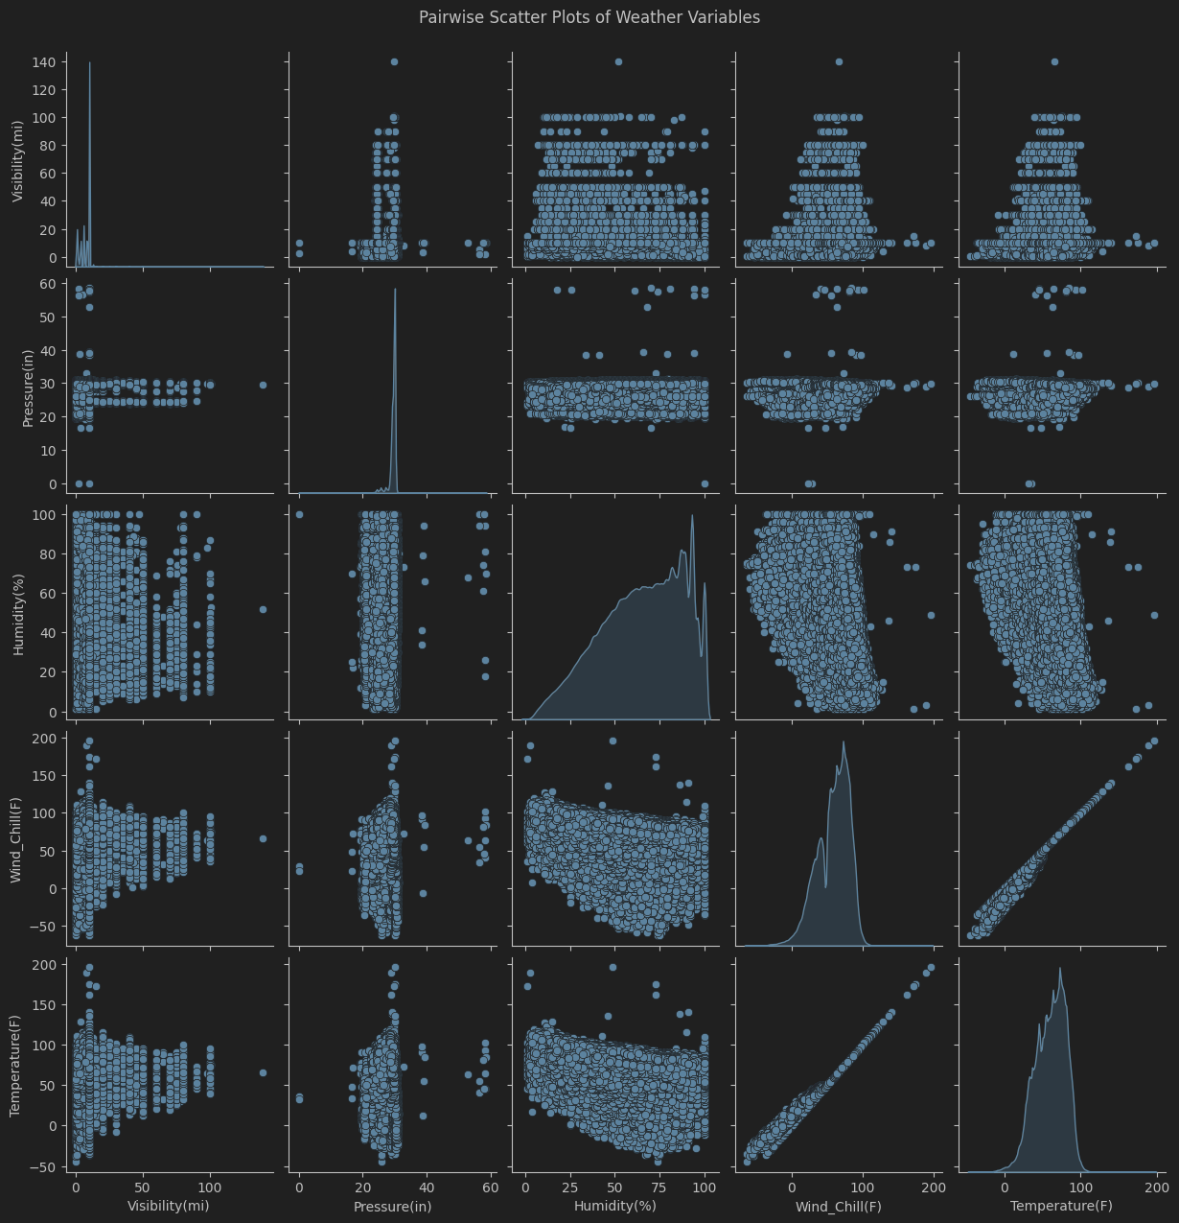
Correlations of all weather condition variables.
We cannot say there is a relation between humidity and visibility, but we can confirm the linear relation between wind chill and temperature.

Slide 12
Hypothesis Testing
T-test Results:
T-statistic: 63.1190
P-value: 0.0000
Interpretation:
The p-value is less than 0.05, indicating a statistically significant difference in accident severity between rainy and other weather conditions.
T-test comparing accident severity in rain vs. other conditions.
Interpretation of results and significance.

Slide 13
Regression Analysis
OLS Regression Results
===================================================
Dep. Variable: Severity R-squared: 0.001
Model: OLS Adj. R-squared: 0.001
Method: Least Squares F-statistic: 2242.
Date: Fri, 28 Feb 2025 Prob (F-statistic): 0.00
Time: 14:51:51 Log-Likelihood: -5.2706e+06
No. Observations: 7551296 AIC: 1.054e+07
Df Residuals: 7551293 BIC: 1.054e+07
Df Model: 2
Covariance Type: nonrobust
======================================================
coef std err t P>|t| [0.025 0.975]
----------------------------------------------------------------------------------
const 2.1998 0.001 3250.405 0.000 2.199 2.201
Rain_Intensity 0.0443 0.001 66.280 0.000 0.043 0.046
Visibility(mi) 0.0009 6.98e-05 13.084 0.000 0.001 0.001
=======================================================
Omnibus: 2567524.467 Durbin-Watson: 1.424
Prob(Omnibus): 0.000 Jarque-Bera (JB): 7580856.232
Skew: 1.813 Prob(JB): 0.00
Kurtosis: 6.309 Cond. No. 42.7
Rain Intensity Analysis:
Coefficient for Rain Intensity: 0.0443
Interpretation: A positive coefficient suggests that higher rain intensity is associated with higher accident severity.
Specifically, for each unit increase in rain intensity, severity is predicted to increase by the coefficient amount, holding visibility constant.
Visibility Analysis:
Coefficient for Visibility: 0.0009
Interpretation: A negative coefficient suggests that lower visibility is associated with higher accident severity.
Specifically, for each 1-mile increase in visibility, severity is predicted to decrease by the coefficient amount, holding rain intensity constant.
P-value Analysis:
The p-values in the model summary indicate the statistical significance of each variable.
Variables with p-values less than 0.05 are generally considered statistically significant.
Check the P>|t| column in the model summary to assess the significance of Rain Intensity and Visibility.

